Slide 1
Dealing with the newly listed northern long eared bat
ACEC-KY/FHWA/KYTC Partnering Conference 2015

Slide 2
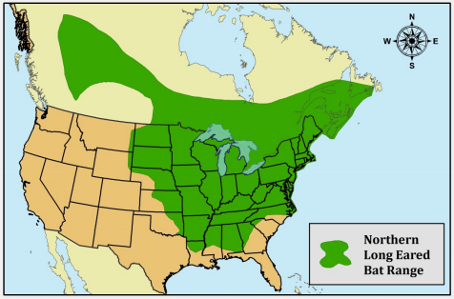
Getting to know NLEB: Range
The northern long-eared bat’s (Myotis septentrionalis) range includes much of the eastern and north central United States, and all Canadian provinces from the Atlantic Ocean west to the southern Yukon Territory. The species’ range includes 37 states.

Slide 3
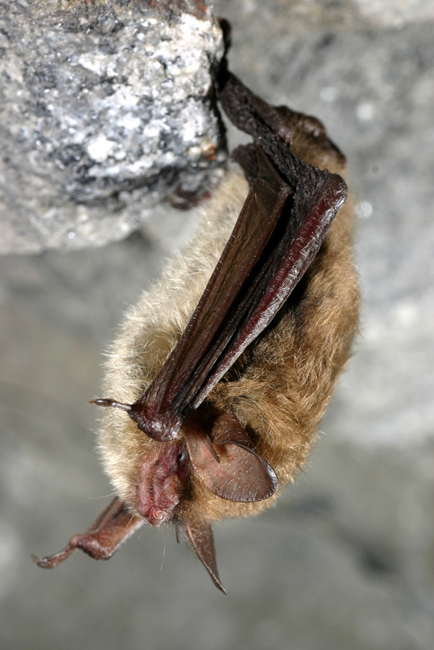
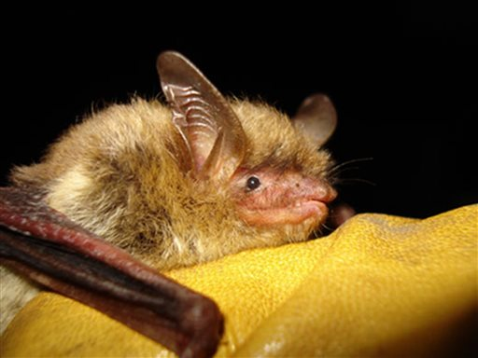
Getting to know NLEB: Appearance
The northern long-eared bat is a medium-sized bat with a body length of 3 to 4 inches and a wingspan of 8 to 10 inches. (photo credit: Al Hicks)

Slide 4
Getting to know NLEB: Habitat
During the summer, northern long-eared bats roost singly or in colonies underneath bark, in cavities or in crevices of both live trees and snags (dead trees). Males and non-reproductive females may also roost in cooler places, like caves and mines. Northern long-eared bats seem to be flexible in selecting roosts, choosing roost trees based on suitability to retain bark or provide cavities or crevices. They have also been found rarely roosting in structures, like barns and sheds.
Northern long-eared bats spend winter hibernating in caves and mines, called hibernacula. They use various-sized caves or mines with constant temperatures and high humidity. Within hibernacula, surveyors find them hibernating most often in small crevices or cracks, often with only the nose and ears visible, making them difficult to accurately count.

Slide 5
Getting to know NLEB: KY status
NLEB has been observed in 90 counties in Kentucky and is considered to be present in all 120 (KY Fish and Wildlife database).
Used to be one of the most commonly captured species in central KY during mist net surveys prior to white nose syndrome.
Geographically Kentucky lies in the heart of the NLEB range.
No priority hibernacula have been identified for NLEB.
The eastern KY coalfields shows a dense distribution of NLEB due to all the Indiana bat surveys over the last couple decades for coal projects and the large number of NLEB that took place. Not much data was collected for NLEB since they were not a protected species.

Slide 7
Adding NLEB to the Endangered Species List
October 2013 FWS proposed listing, final listing published in April 2015, and became effective May 2015
Over 10,000 comments
Pressure from timber, oil and gas industries that would be affected by the listing resulted in 13 US Senators writing a letter to Dept. of Interior requesting they reconsider federal protection for NLEB
NLEB listed as Threatened 4(d)

Slide 8
Why the controversy?
NLEB was given federal protection under endangered species act due to white nose syndrome not habitat loss.
White-nose syndrome originated in northeast and quickly spread. New York experienced mortality in caves up to 99%. The disease quickly spread south and west decimating bat populations.
Mortality hasn’t been as drastic in states with mild winters.

Slide 9
ROOSTING HABITAT: NLEB vs IB
INDIANA BAT
Typically day roost in trees in riparian, bottomland and upland forest.
Primary maternity roosts are most often snags and/or dead trees with exfoliating bark, or other characteristics that provide shelter.
Alternate roosts can be live shaggy bark trees (e.g. shag bark hickory, maple, hickory, oak, elm, ash, hemlock). Structure within the tree is more important than species of tree.
≥16 inches diameter at breast height (dbh) optimal for primary maternity roosts
≥9 inches dbh can often be used as alternate roosts
Female observed on tree 5.5 inches dbh
Male observed on tree 2.5 inches dbh

Slide 10
ROOSTING HABITAT CONT.
NORTHERN LONG EARED BAT
Typically found in forest stands, but have been observed in man-made structures (buildings, barns, bat houses, etc.)
Maternity roosts beneath exfoliating bark and in tree cavities. Males and non-reproductive females may also roost in caves, mines, abandoned mine portals, railroad tunnels, etc.
NLEB maternity roosts are more general. Smaller tree size (3 inches dbh) and even in cedar snags and burn piles.

Slide 11
BIGGEST CHANGES TO KYTC
NO TREE CLEARING IN JUNE AND JULY!! Used to only be in Indiana bat maternity areas but now is entire state.
Non-volant pups are in the maternity roost trees during this time.
Cutting down a roost tree with non-volant pups increases the likelihood for direct mortality because pups could be crushed or abandoned. It is also likely to add increased stress on females that are caring for the pups.

Slide 12
Adjusting to the new listing
KYTC was required to assess the status of every project in the state currently under construction to ensure NLEB was being addressed.
Some projects were required to halt tree-clearing and construction until a decision could be made on how to best address impacts to the newly listed species.
A list of every active construction project was sent to US Fish and Wildlife prior to May 4th 2015.

Slide 13
Three approaches to clearing projects for impacts to NLEB
Conservation Strategy for Forest-Dwelling Bats in Kentucky
FHWA guidance
Threatened 4(d) ruling

Slide 14
Conservati0n Strategy for Forest-Dwelling Bats
Authored by USFWS-FFO for use in KY (available on http://www.fws.gov/frankfort/ )
Mandates no tree clearing in June and July for entire state.
Still allows for presence absence surveys for projects in “potential habitat”
Allows for KYTC to enter into a CMOA to account for take (tree removal).

Slide 15
Conservati0n Strategy for Forest-Dwelling Bats cont.
Site specific Evaluation required for:
Projects clearing more than 100 acres
Projects within 1 mile of P1/P2 hibernacula or ½ mile of P3/P4 hibernacula

Slide 16
Conservati0n Strategy for Forest-Dwelling Bats cont.

Slide 17
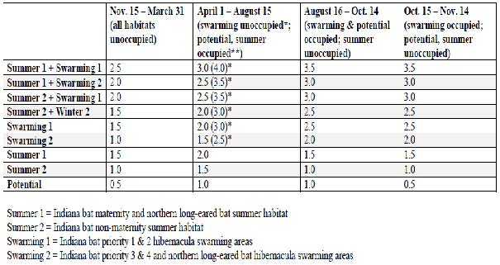
Conservati0n Strategy for Forest-Dwelling Bats cont.
Uses the statewide USDA land costs as index for habitat replacement costs (currently $3,150 per acre of habitat lost) (Cost is re-evaluated beginning of August)
Mitigation multipliers consider both habitat type/use and nature/timing of adverse effects (direct/indirect)

Slide 18
Conservati0n Strategy for Forest-Dwelling Bats cont.
Reporting usage of the CMOA:
Monthly ledger filled out by biologists and sent to USFWS approx. 2 weeks after letting occurs
USFWS reviews the ledger and sends to third party , Kentucky Native Lands Trust
KNLT invoices KYTC for each monthly letting and the money is paid from the available funds (design or construction funds)

Slide 19
FHWA Guidance
Informal Consultations only (no payments, projects result in a No effect or Not Likely to Adversely Affect)
Only addresses improvements along an existing highway
ALL TREES must lie within 100 feet of existing pavement
Clearing occurs outside of “Active Season” (for KY that is October 15-March 31)
Doesn’t remove documented roost trees (none in KY within 100 feet of pavement)
APPLIES TO ANY HABITAT TYPE!!

Slide 20
FHWA Guidance cont.
Use of FHWA guidance is documented with a project submittal form (Appendix A of User Guide) to be completed by biologists after consulting with Environmental Coordinators and Project Managers
Project Submittal Form sent to USFWS and no reply within 14 days = USFWS concurrence
Usage is available to all states within NLEB range
MUST HAVE FEDERAL MONEY USED ON PROJECT

Slide 21
FHWA Guidance cont
Also provides guidance for checking bridges for bats/roost potential.
If bats are observed using bridge or potential for roosting is present then some specific minimization measures pertaining to the deconstruction of the bridge may be prescribed (winter restrictions, final inspection of bat usage 7 days before project starts, night restrictions, exclude bats if necessary)

Slide 22
Threatened 4(d)
NO FEDERAL NEXUS PROJECTS ONLY
Routine maintenance of ROW or expansion of corridor by up to 100 feet of existing cleared ROW
Projects resulting in less than 1 acre of removal (culvert or bridge replacements)
Hazardous tree removal is permitted
DEA is still developing a mechanism to document usage of the 4(d) rule.
For now provides cover for all state-funded maintenance activities to take place.

Slide 23
Threatened 4(d) cont.
Must adhere to conservation measures:
Project occurs more than 0.25 miles from a known hibernacula
No clearing of known occupied roost trees during June and July (none in Kentucky)
Avoid clear-cuts within 0.25 miles of a known occupied roost tree during June and July (none in Kentucky)
ALL HABITAT TYPES ARE APPLICABLE!

Slide 24
How will NLEB listing affect KYTC longterm?
More expensive to mitigate in areas of known NLEB occurrence (east KY, karst plains of central KY, along Ohio River)
Schedule certain project letting to avoid the June and July restrictions
Designing improvements along existing roads to accommodate FHWA guidance
MORE WINTER TREE CLEARING

Slide 25
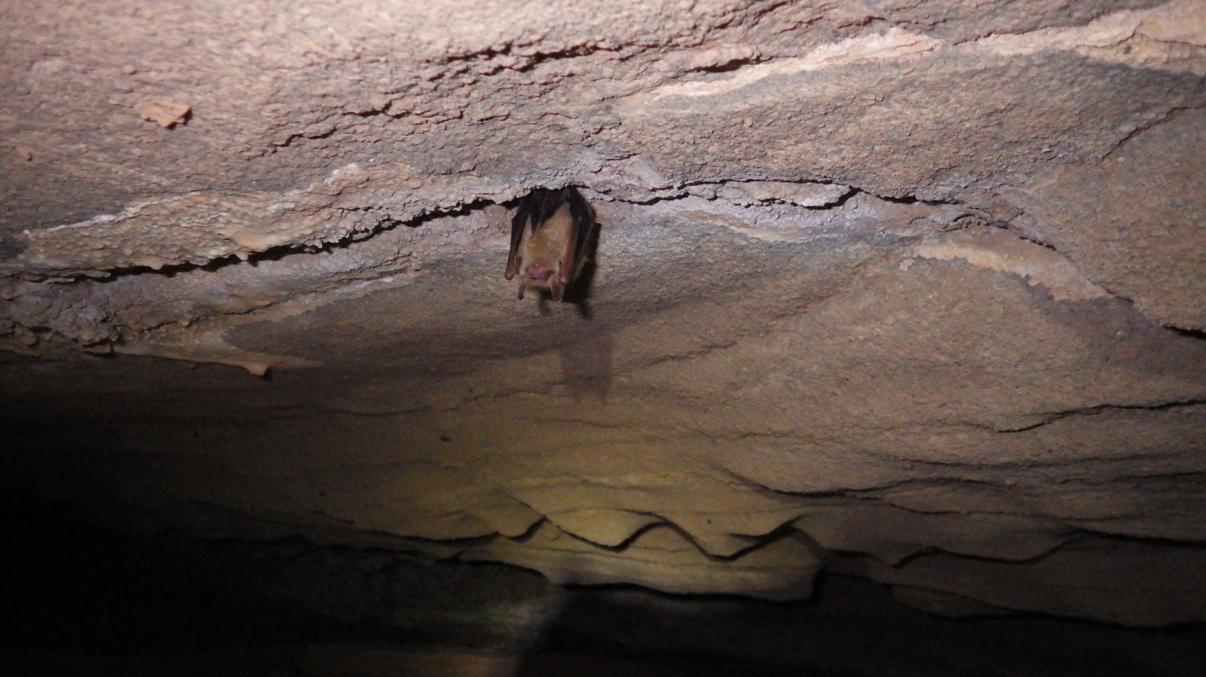
Conclusion
Any questions/concerns??

